Slide 1
Computer Engineering
and Information Technologies
Department
Internationalization.
educational and research activities

Slide 2
Department History
1988 - the first enrollment of students in the specialty of computers, complexes, systems and networks
1989 - Department of Electronic Computing Systems was established.
1995 - Department was renamed to the Department of Computer Systems
2004 - the specialty: system programming was opened,
2016 - the name of the department was changed to Computer Engineering and System Programming (CESP).
2021 - the department was renamed to the Department of Computer Engineering and Information Systems.

Slide 3
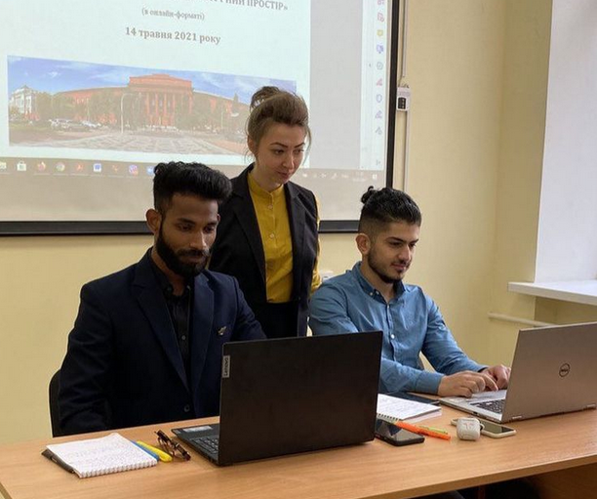
EDUCATIONAL WORK
123 computer engineering
Educational program “Computer engineering and Programming”
126 Information systems and Technologies
Educational program
“Information systems and Technologies”
Educational degrees:
bachelor
master
PhD

Slide 4
SCIENTIFIC WORK
Scientists of the department are actively engaged in scientific work: results are presented in dissertations, publications of scientific results in professional journals from the list approved by the Ministry of Education and Science of Ukraine and publications indexed in Scopus, Web of Science, DBLP, Google Scholar, perform work on state budget topics and grant projects.

Slide 5
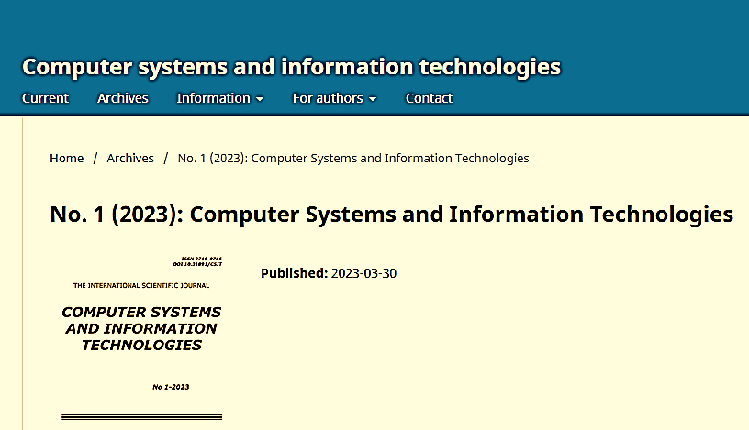
SCIENTIFIC WORK
The department publishes the English-language scientific journal Computer systems and information technologies (ISSN 2710-0766, ISSN 2710-0774 (online), which has been published since 2020 and is included in category B.
The department is responsible for the learning of PhD students in the specialties 123 Computer Engineering and 126 Information Systems and Technologies

Slide 6
IntelITSIS Workshop
The International Workshop on Intelligent Information Technologies & Systems of Information Security (IntelITSIS).
The workshop is focused on all technical and practical aspects of the latest research and results of international academicians, scientists and practitioners related to intelligent information technologies & systems of information security.
Workshop provides opportunities to exchange new ideas, to establish business or research relations and to find global partners for future collaboration.

Slide 7
INTERNATIONAL PROJECTS
The priority area of the department activity is participation in international projects aimed at developing cooperation with leading educational institutions of the European Union.
The main purpose of such interaction is:
improving the quality of educational services;
improving the material and technical base of the department;
providing internship opportunities for teachers and students in leading educational institutions of the European Union.
Teachers of the department are active co-executors of a number of Erasmus+ projects

Slide 8
INTERNATIONAL PROJECTS
ERASMUS+ MOVEx – Development of the Model and Open database of Virtual national and international academic Exchange programs to facilitate the university students’ academic mobility and international cooperation (15.12.2022 – 15.12.2025)
ERASMUS+ SMART-PL – Students’ Personalised Learning Model, Based on the Virtual Learning Environment of Intellectual Tutoring “Learning with No Limits” (01.01.2023 – 31.12.2025)
NAWA Green Transition in Ukrainian Universities (01.01.2023 – 31.12.2023)

Slide 9
International Internship
Researchers of the Department passed International Internship at
Royal Institute of Technology (Stockholm)
UTP University of Science and Technology (Bydgoszcz, Poland),
Lublin University of Technology (Poland).
University of Bielsko-Biala, Poland

Slide 10
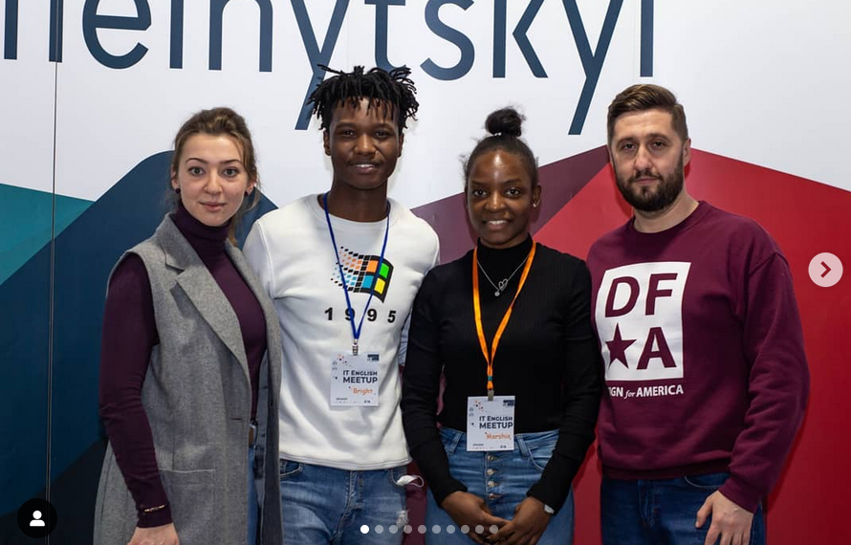
Student Design Bureau
As part of the student research work, the Student Design Bureau operates at the Department, an organization that brings together students on a voluntary basis who are actively involved in applied research and development work at the department.

Slide 11
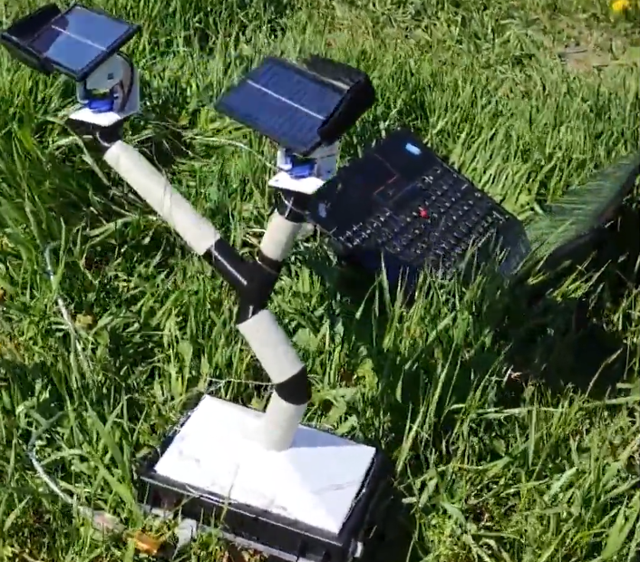
Student Design Bureau Projects
Video digest

